Slide 1


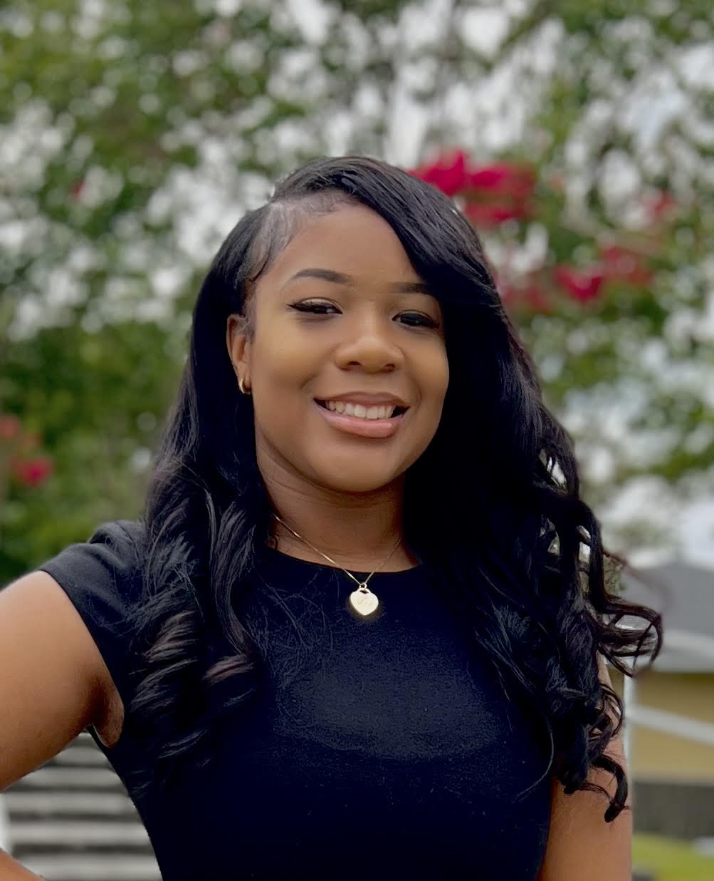


Westside High School
East Georgia State College
Associates
Psychology
Paine College
Bachelors
Sociology
University Of Phoenix Masters
Education
Ms. Chasity Mullins
Health/ Personal Fitness
Ask questions, make mistakes, live…LEARN

